Slide 1


Slide 2
Lewin’s Change Model Template 1
Determines what needs to change
Create the need for change
Manage & understand the doubts & concerns
Unfreeze
This slide is 100% editable. Adapt it to your needs and capture your audience's attention.
Communicate often
Dispel rumors
Empower action
Involve people in the process
Change
This slide is 100% editable. Adapt it to your needs and capture your audience's attention.
Anchor the changes into the culture
Develop ways sustain the change
Provide support & Training
Celebrate successes
Refreeze
This slide is 100% editable. Adapt it to your needs and capture your audience's attention.

Slide 3
KEY ACTIVITIES
Unfreezing
Changing
Refreezing
“Readiness to Change”
“Implementation”
“Making it Stick”
Educate (Everyone understands)
Inform (What, Why, When, How)
Consult (Seek views & ideas, allow thinking time, use others’ ideas )
Plan (Objectives, resources, time-scales, measures, budgets)
Organise (Work plans)
Appoint (Leaders, managers, teams)
Praise
Encouragement
Recognition & Empathy
Coach
Train
Lead
Manage
Help & Guidance
Regular Feedback
Provide adequate resources
Set performance indicators
Monitor & evaluate performances
Establish systems to make it happen
Establish controls to check it is happening
Rewards for new behaviour
Sanction (or lack of reward) for old behaviour
A period of relative stability (consolidate)
We have mentioned a framework of Lewin’s three stage model, you can use it as per your requirements

Slide 4

Lewin’s Change Model Template 2
01
Unfreezing to become motivated to change
This slide is 100% editable. Adapt it to your needs and capture your audience's attention.
02
Changing What Needs To Be Changed
This slide is 100% editable. Adapt it to your needs and capture your audience's attention.
03
Refreezing to make change permanent
Lewin’s Change Model
This slide is 100% editable. Adapt it to your needs and capture your audience's attention.

Slide 5
Lewin’s Change Model Template 3
Initial Problem Identification
Preparing the ground & Communication
Obtaining Data
This slide is 100% editable. Adapt it to your needs and capture your audience's attention.
Unfreeze
Obtaining Data
Problem Diagnosis
Action Planning
Implementation
Follow up & Stabilization
Assessment
Change
This slide is 100% editable. Adapt it to your needs and capture your audience's attention.
Refreeze
Assessment of Consequences
Ongoing Monitoring
Learning from Process
This slide is 100% editable. Adapt it to your needs and capture your audience's attention.

Slide 6
Lewin’s Change Model Template 4
Unfreeze
Change
This slide is 100% editable. Adapt it to your needs and capture your audience's attention.
Refreeze
This slide is 100% editable. Adapt it to your needs and capture your audience's attention.
This slide is 100% editable. Adapt it to your needs and capture your audience's attention.
This slide is 100% editable. Adapt it to your needs and capture your audience's attention.
This slide is 100% editable. Adapt it to your needs and capture your audience's attention.
This slide is 100% editable. Adapt it to your needs and capture your audience's attention.

Slide 7
Lewin’s Change Model Template 5
Unfreeze
Change
Refreeze
This slide is 100% editable. Adapt it to your needs and capture your audience's attention.
This slide is 100% editable. Adapt it to your needs and capture your audience's attention.
This slide is 100% editable. Adapt it to your needs and capture your audience's attention.

Slide 8
Lewin’s Change Model Template 6
Feedback Loop
Feedback Loop
Feedback Loop
Planning
Action
Results
This slide is 100% editable. Adapt it to your needs and capture your audience's attention.
This slide is 100% editable. Adapt it to your needs and capture your audience's attention.
This slide is 100% editable. Adapt it to your needs and capture your audience's attention.
Unfreeze
Change
Refreeze

Slide 9
Additional Slides

Slide 10
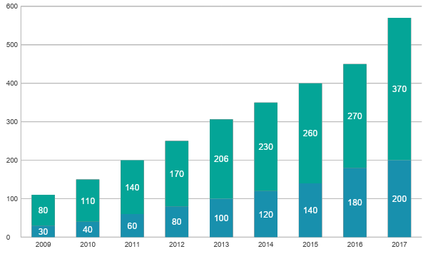
Stacked Column
Product 01
This slide is 100% editable. Adapt it to your needs and capture your audience's attention.
Product 02
This slide is 100% editable. Adapt it to your needs and capture your audience's attention.
This graph/chart is linked to excel, and changes automatically based on data. Just left click on it and select “Edit Data”.

Slide 11
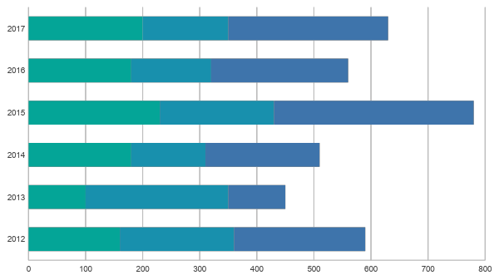
Stacked Bar
Product 01
This slide is 100% editable. Adapt it to your needs and capture your audience's attention.
Product 02
This slide is 100% editable. Adapt it to your needs and capture your audience's attention.
Product 03
This slide is 100% editable. Adapt it to your needs and capture your audience's attention.
This graph/chart is linked to excel, and changes automatically based on data. Just left click on it and select “Edit Data”.

Slide 12
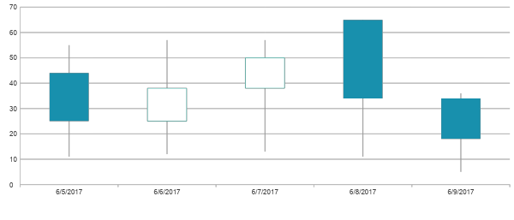
Open High Low Close
HIGH
Product 01
This slide is 100% editable. Adapt it to your needs and capture your audience's attention.
Product 02
LOW
Close
This slide is 100% editable. Adapt it to your needs and capture your audience's attention.
OPEN
This graph/chart is linked to excel, and changes automatically based on data. Just left click on it and select “Edit Data”.

Slide 13



Meet Our Team
Marry Graves
John Smith
Sofia Mike
CEO
Financial Manager
Marketing manager
This slide is 100% editable. Adapt it to your needs and capture your audience's attention.
This slide is 100% editable. Adapt it to your needs and capture your audience's attention.
This slide is 100% editable. Adapt it to your needs and capture your audience's attention.

Slide 14
Target
Text Here
Text Here
This slide is 100% editable. Adapt it to your needs and capture your audience's attention.
04
01
This slide is 100% editable. Adapt it to your needs and capture your audience's attention.
Text Here
Text Here
This slide is 100% editable. Adapt it to your needs and capture your audience's attention.
03
02
This slide is 100% editable. Adapt it to your needs and capture your audience's attention.

Slide 15

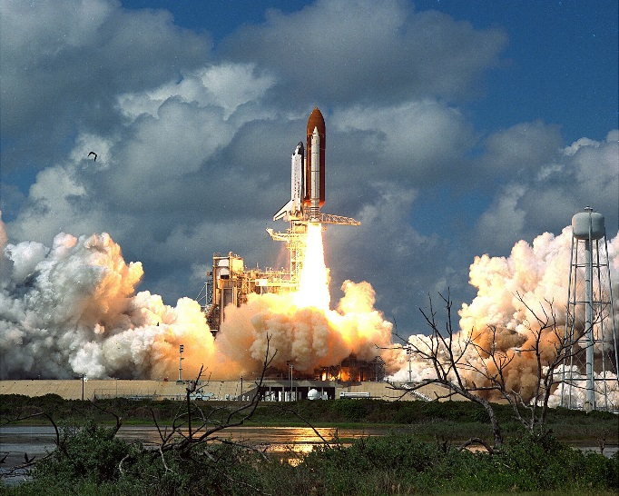

Our Mission
Vision
Mission
Goal
This slide is 100% editable. Adapt it to your needs and capture your audience's attention.
This slide is 100% editable. Adapt it to your needs and capture your audience's attention.
This slide is 100% editable. Adapt it to your needs and capture your audience's attention.

Slide 16


